Slide 1
What Is Social Responsibility?
The Classical View
Management’s only social responsibility is to maximize profits (create a financial return) by operating the business in the best interests of the stockholders (owners of the corporation).
Expending the firm’s resources on doing “social good” unjustifiably increases costs that lower profits to the owners and raises prices to consumers.

Slide 2
What Is Social Responsibility? (cont’d)
The Socioeconomic View
Management’s social responsibility goes beyond making profits to include protecting and improving society’s welfare.
Corporations are not independent entities responsible only to stockholders.
Firms have a moral responsibility to larger society to become involved in social, legal, and political issues.
“To do the right thing”

Slide 3
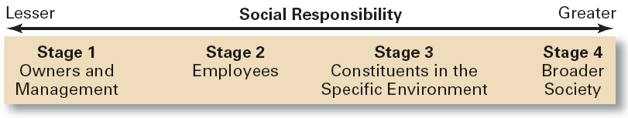
Exhibit 5–1 To Whom is Management Responsible?

Slide 4
Exhibit 5–2 Arguments For and Against Social Responsibility
For
Public expectations
Long-run profits
Ethical obligation
Public image
Better environment
Discouragement of further governmental regulation
Balance of responsibility and power
Stockholder interests
Possession of resources
Superiority of prevention over cure
Against
Violation of profit maximization
Dilution of purpose
Costs
Too much power
Lack of skills
Lack of accountability

Slide 5
From Obligation to Responsiveness to Responsibility
Social Obligation
The obligation of a business to meet its economic and legal responsibilities and nothing more.
Social Responsiveness
When a firm engages in social actions in response to some popular social need.
Social Responsibility
A business’s intention, beyond its legal and economic obligations, to do the right things and act in ways that are good for society.

Slide 6
Does Social Responsibility Pay?
Studies appear to show a positive relationship between social involvement and the economic performance of firms.
Difficulties in defining and measuring “social responsibility” and “economic performance raise issues of validity and causation in the studies.
Mutual funds using social screening in investment decisions slightly outperformed other mutual funds.
A general conclusion is that a firm’s social actions do not harm its long-term performance.

Slide 7
The Greening of Management
The recognition of the close link between an organization’s decision and activities and its impact on the natural environment.
Global environmental problems facing managers:
Air, water, and soil pollution from toxic wastes
Global warming from greenhouse gas emissions
Natural resource depletion

Slide 8
How Organizations Go Green
Legal (or Light Green) Approach
Firms simply do what is legally required by obeying laws, rules, and regulations willingly and without legal challenge.
Market Approach
Firms respond to the preferences of their customers for environmentally friendly products.
Stakeholder Approach
Firms work to meet the environmental demands of multiple stakeholders—employees, suppliers, and the community.
Activist Approach
Firms look for ways to respect and preserve environment and be actively socially responsible.

Slide 9
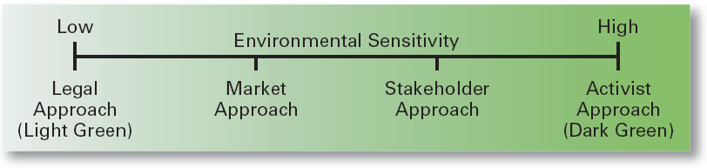
Exhibit 5–5 Approaches to Being Green
Source: Based on R.E. Freeman. J. Pierce, and R. Dodd. Shades of Green: Business Ethics and the Environment (New York: Oxford University Press, 1995).

Slide 10
Managerial Ethics
Ethics Defined
Principles, values, and beliefs that define what is right and wrong behavior.

Slide 11
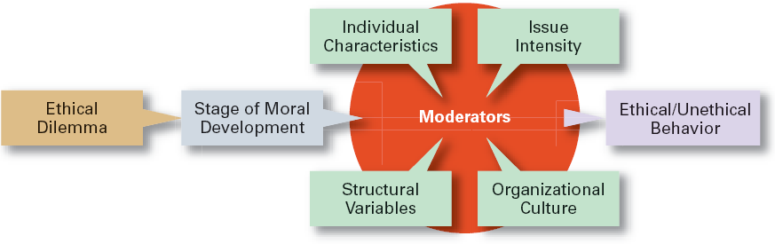
Exhibit 5–8 Factors That Affect Ethical and Unethical Behavior

Slide 12
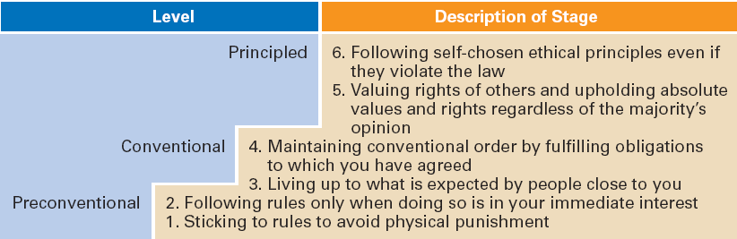
Exhibit 5–9 Stages of Moral Development
Source: Based on L. Kohlberg, “Moral Stages and Moralization: The Cognitive-Development Approach,” in T. Lickona (ed.). Moral Development and Behavior: Theory, Research, and Social Issues (New York: Holt, Rinehart & Winston, 1976), pp. 34–35.

Slide 13
Individual Characteristics Affecting Ethical Behaviors
Values
Basic convictions about what is right or wrong on a broad range of issues

Slide 14
Individual Characteristics
Personality Variables
Ego strength
A personality measure of the strength of a person’s convictions
Locus of Control
A personality attribute that measures the degree to which people believe they control their own life.
Internal locus: the belief that you control your destiny.
External locus: the belief that what happens to you is due to luck or chance.

Slide 15
Other Variables
Structural Variables
Organizational characteristics and mechanisms that guide and influence individual ethics:
Performance appraisal systems
Reward allocation systems
Behaviors (ethical) of managers
An Organization’s Culture
Intensity of the Ethical Issue

Slide 16
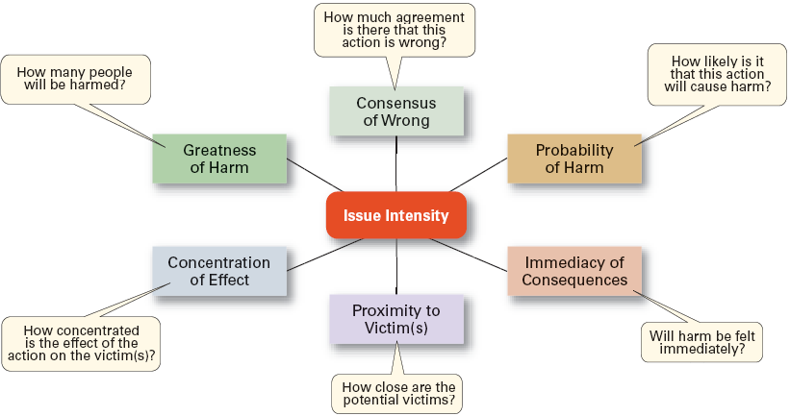
Exhibit 5–10 Determinants of Issue Intensity

Slide 17
How Managers Can Improve Ethical Behavior in An Organization
Hire individuals with high ethical standards.
Establish codes of ethics and decision rules.
Lead by example.
Set realistic job goals and include ethics in performance appraisals.
Provide ethics training.
Conduct independent social audits.
Provide support for individuals facing ethical dilemmas.

Slide 18
Effective Use of a Code of Ethics
Develop a code of ethics as a guide in handling ethical dilemmas in decision making.
Communicate the code regularly to all employees.
Have all levels of management continually reaffirm the importance of the ethics code and the organization’s commitment to the code.
Publicly reprimand and consistently discipline those who break the code.

Slide 19
Ethical Leadership
Managers must provide a good role model by:
Being ethical and honest at all times.
Telling the truth; don’t hide or manipulate information.
Admitting failure and not trying to cover it up.
Communicating shared ethical values to employees through symbols, stories, and slogans.
Rewarding employees who behave ethically and punish those who do not.
Protecting employees (whistleblowers) who bring to light unethical behaviors or raise ethical issues.

Slide 20
Managing Ethical Lapses and Social Irresponsibility
Provide ethical leadership
Protect employees who raise ethical issues (whistle-blowers)

Slide 21
Chapter 7
Managing Change and Innovation

Slide 22
What Is Change?
Organizational Change
Any alterations in the people, structure, or technology of an organization
Characteristics of Change
Is constant yet varies in degree and direction
Produces uncertainty yet is not completely unpredictable
Creates both threats and opportunities
Managing change is an integral part of every manager’s job.

Slide 23
Forces for Change
External forces
Marketplace
Governmental laws and regulations
Technology
Labor market
Economic changes
Internal Forces
Changes in organizational strategy
Workforce changes
New equipment
Employee attitudes

Slide 24
The Manager as Change Agent
Change Agents
People who act as catalysts and assume the responsibility for changing process are called change agents.
Types of Change Agents
Managers: internal entrepreneurs
Nonmanagers: change specialists
Outside consultants: change implementation experts

Slide 25
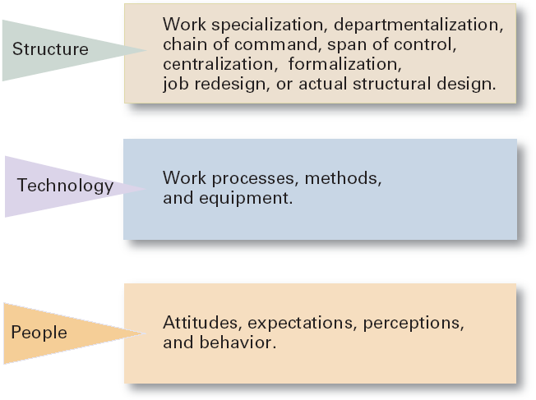
Three Categories of Change
Exhibit 13.2

Slide 26
Types of Change
Structural
Changing the organization’s structure or its structural components
Technological
Adopting new equipment or operating methods that displace old skills and require new ones
Automation: replacing certain tasks done by people with machines
Computerization
Workforce
Changing attitudes, expectations, perceptions, and behaviors of the workforce
Organizational
development (OD)
Techniques or programs to change people and the nature and quality of interpersonal work relationships.

Slide 27
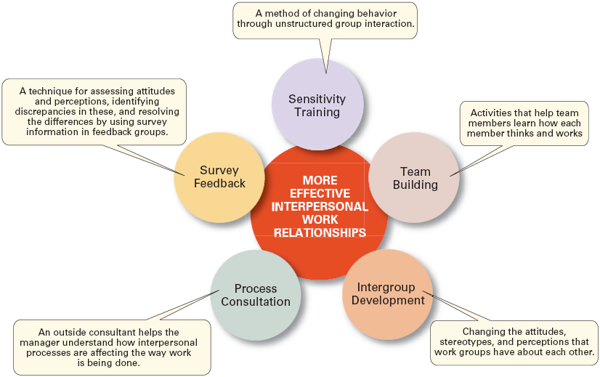
Organizational Development Techniques
Exhibit 13.3

Slide 28
Managing Resistance to Change
Why People Resist Change?
The ambiguity and uncertainty that change introduces
The comfort of old habits
A concern over personal loss of status, money, authority, friendships, and personal convenience
The perception that change is incompatible with the goals and interest of the organization

Slide 29
Managerial Actions to Reduce Resistance to Change
Education and Communication
Participation
Facilitation and Support
Negotiation
Manipulation and Co-optation
Coercion
Exhibit 13.4

Slide 30
Characteristics of Change-Capable Organizations
Link the present and the future.
Make learning a way of life.
Actively support and encourage day-to-day improvements and changes.
Ensure diverse teams.
Encourage mavericks.
Shelter breakthroughs
Integrate technology.
Build and deepen trust.
Exhibit 13.8

